Slide 1
Linear Regression
Y.LAKSHMI PRASAD
08978784848

Slide 2
Assumptions
Linear regression assumptions:
The relationship between X and Y is linear (Linearity).
Y is distributed normally at each value of X (Normality).
The variance of Y at every value of X is the same – (No Heteroscedasticity).
The observations are independent – (No Autocorrelation).
Independent variables should not be correlated – (No Multicollinearity).

Slide 3
Residual Analysis
Residual Analysis visually evaluates the above assumptions and helps to determine whether the regression model that has been selected is appropriate.
The residual or estimated error value ei, is the difference between the observed (Yi) and the predicted ( ) values of the dependent variable for a given value Xi
A residual appears on a scatter plot as the vertical distance between an observed value of Y and the prediction line.

Slide 4
Linearity
1. Relationship between the input variables and the output variable is assumed to be linear.
2. The linearity can be checked using the scatter plots.
3. If the relationship is not linear, create derived variables that transform the inputs so that the relationship to the target becomes linear.

Slide 5
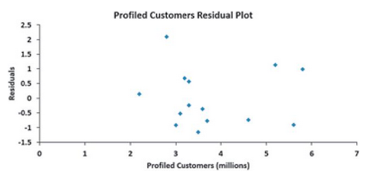
Linearity
1. Using Residual plot, If the linear model is appropriate for the data, you will not see any apparent pattern in the plot.
2. If the linear model is not appropriate, in the residual plot, there will be a relationship between the Xi values and the residuals.
3. To assess linearity, residuals are plotted against the independent variable.
Example for a residual plot with no clear pattern is shown below,

Slide 6
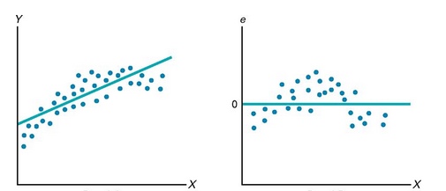
Linearity
Plot – 1 Plot - 2
In the above plots, plot-1 shows that relationship between X and Y are curvilinear.
Plot-2 shows that there is a clear relationship between X_{i} and e_{i}
For this case, a quadratic or curvilinear model is a better fit and should be used instead of the simple linear model.

Slide 7
Linearity
Linear Rainbow Test
The basic idea of the Rainbow-Test is that even if the true relationship is nonlinear, over a subsample of data given a good linear fit can be achieved.
The null hypothesis is rejected whenever the overall fit is significantly inferior to the fit of the subsample.
The test statistic under H0 follows a F distribution with df1 and df2 degree of freedom.
This particular procedure compares a subsample consisting of all data points without the upper and lower quartile (of time index), thus 50 data points.
If the true relationship is concave or convex, the null hypothesis should be rejected.

Slide 8
Independence of errors
This requires the errors be independent of one another.
This assumption is particularly important when data are collected over a period of time.
In such cases, the errors in a specific time period are sometimes correlated with those of the previous time period.
This assumption can be evaluated by plotting the residuals in the order or sequence in which the data were collected.
If the values of Y are part of Time Series, a residual may sometimes be related to the residual that precedes it.
If the relationship exists between consecutive residuals, the plot will often show a cyclical pattern.

Slide 9
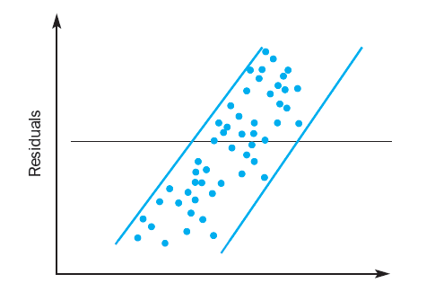
Independence of errors
A plot of residuals against time will give us an understanding of whether the error terms are correlated or uncorrelated
If the plot shows a random pattern, then the assumption lies true.
Durbin Watson Test is used for examining the correlations between the error terms
Time
Plot indicating a Linear Relationship between residuals and Time

Slide 10
Independence of errors
Durbin-Watson Test
Durbin-Watson statistic is used to measure autocorrelation.
This statistic measures the correlation between each residual and the residual over the previous time period.
Durbin-Watson statistic will approach 0, if successive residuals are positively auto-correlated.
If the residuals are not correltated, It will be close to 2.
if the residuals are negatively autocorrelated, It will be greater than 2 and could even approach its maximum value of 4.
The Null Hypothesis of the test is that there is no serial correlation.

Slide 11
Normality
This assumption requires the errors (ε_{i}) be normally distributed at each value of X.
As long as the distribution of the errors at each level of X is not extremely different from a normal distribution, inferences about β₀ and β₁ are not seriously affected.
Normality can be evaluated by constructing a histogram of standardized residuals or a normal probability plot of standardized residuals, Q-Q Plots.

Slide 12
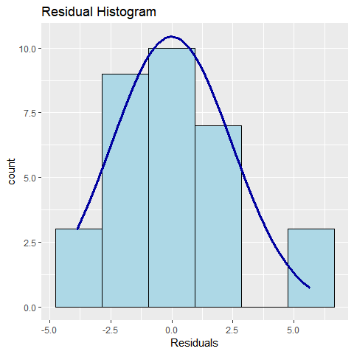
Normality
Histogram of standardized residuals
For histogram, the residuals are organized into a frequency distribution.
The histogram is plotted with residuals in x axis and frequency in Y axis.

Slide 13
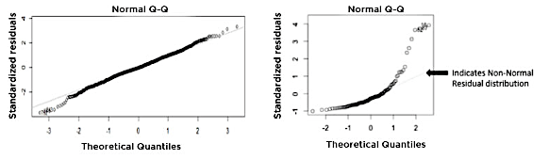
Normality
Q-Q plot
This plot compares the observed data against the quantiles (Q) of the assumed distribution.
This plots the standardized (z-score) residuals against the theoretical normal quantiles.
Below are the Q-Q plot’s showing Linearity vs Non Linearity

Slide 14
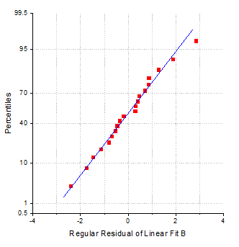
Normality
Normal Probability plot is a special case of Q-Q probability plot for a normal distribution.
It can be used to check whether the variance is normally distributed as well.
The plot is based on the percentiles versus ordered residuals, the percentiles are estimated by (i – 3/8) / (n + ¼)
Where n is the total number of data and the i is the ith data.

Slide 15
Normality
Jarque Bera Test
The Jarque–Bera test is a goodness-of-fit test of whether sample data have the skewness and kurtosis matching a normal distribution.
Note that this test generally works good for large enough number of data samples(>2000) as the test statistics asymptotically has a chi squared distribution with degrees 2 of freedom.
If the Data is not normal a non linear transformation ( e.g. Log Transformation) can fix the issue.

Slide 16
Equal Variance or Homoscedasticity
This assumption requires that the variance of the errors be constant for all values of X.
In other words, the variability of Y values is the same when X is a low value as when X is a high value.
This can be examined by plotting the standardized residuals against the standardized predicted values of the dependent variable
If the pattern is not random, the variance of the error term is not constant

Slide 17
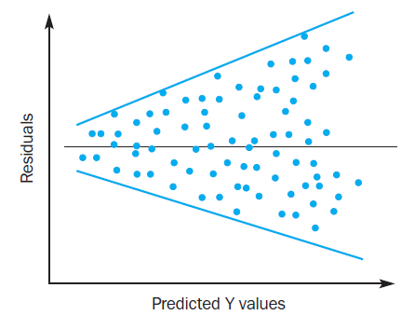
Equal Variance or Homoscedasticity
Below is the residual plot indicating that variance is not constant.
This plot is fan or funnel shaped because the variability of the residuals increases dramatically as X increases.
As this plot shows unequal variances of the residuals at different levels of X, the equal variance assumption becomes invalid.

Slide 18
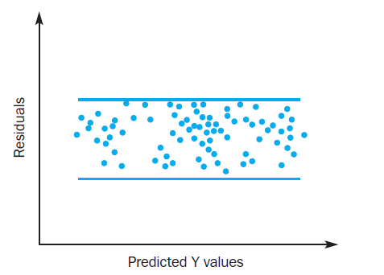
Equal Variance or Homoscedasticity
Plot of residuals indicating that a fitted model is Appropriate

Slide 19
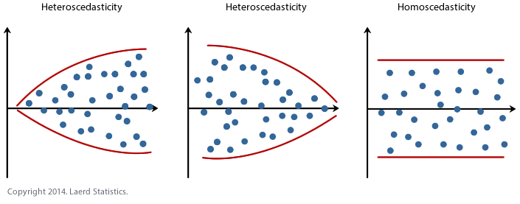
Equal Variance or Homoscedasticity
Plots showing the difference between homoscedasticity and heteroscedasticity.
A classic example of heteroscedasticity is If you model household consumption based on income, you’ll find that the variability in consumption increases as income increases.

Slide 20
Equal Variance or Homoscedasticity
Tests for heteroscedasticity of errors in regression
Goldfeld-Quandt Test:
Given a known time T, the Goldfeld-Quandt tests the null-hypothesis: variances at time 1..T and T..n are equal.
Breusch-Pagan-Test:
It is a chi-squared test: the test statistic is distributed nχ2 with k degrees of freedom.
If the test statistic has a p-value below an appropriate threshold (e.g. p < 0.05) then the null hypothesis of homoskedasticity is rejected and heteroskedasticity assumed.

Slide 21
Multicollinearity
Multicollinearity refers to a situation where multiple predictor variables are correlated with each other.
Since multiple variables are involved, you cannot use the rather simplified 'correlation coefficient' to measure co-linearity (it only measures the correlation between two variables).

Slide 22
Multicollinearity
Since one of the major goal of linear regression is identifying the important explanatory variables, it is important to assess the impact of each and then keep those which have a significant impact on the outcome. This is the major issue with Multicollinearity.
Multicollinearity makes it difficult to assess the effect of individual predictors.

Slide 23
Multicollinearity
A simple way to detect Multicollinearity is to look at the correlation matrix.
We can use Heat map to find the Multicollinearity.
The statistical test VIF(Variance Inflation Factor) is often used to detect Multicollinearity.

Slide 24
VIF(Variance Inflation Factor)
Variance Inflation Factor - A Useful Measure of Multicollinearity.
VIF(Variance Inflation Factor) to measure the correlation of one variable with multiple variables.

Slide 25
VIF(Variance Inflation Factor)
A variable with a high VIF means it can be largely explained by other independent variables.
Thus, you have to check and remove variables with a high VIF after checking for p-values, implying that their impact on the outcome can largely be explained by other variables.
But remember, variables with a high VIF or Multicollinearity may be statistically significant p<0.05, in which case you will first have to check for other insignificant variables before removing the variables with a higher VIF and lower p-values.

Slide 26
VIF-Check our understanding
If a variable “A” has a high VIF (>5), which of the following is true?
A) Variable “A” explains the variation in Y better than variables with a lower VIF
B) Variable “A” is highly correlated with other independent variables in the model
C) Variable A is insignificant (p>0.05)
D) Removing A from the model will increase the adjusted R-squared

Slide 27
What needs to be done when regression assumptions are not met?

Slide 28
Transformations
If an examination of the residuals indicate that the assumptions underlying linear regression are not met, one must transform the variables.
Such as taking logs, square roots, or reciprocals, can stabilize the variance, make the distribution normal, or make the relationship linear.

Slide 29
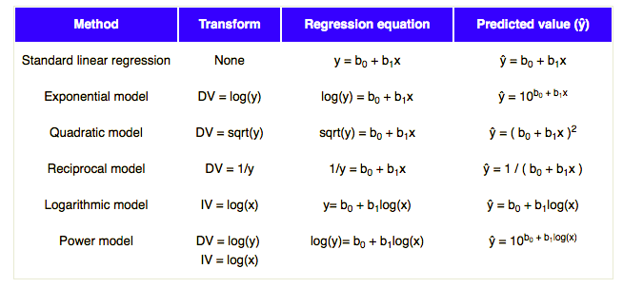
Transformations
Transforming Variables to Achieve Linear
Each Row shows a different transformation method.
Transform column shows the method of transformation to be applied on DV or IV.
Regression equation is the equation used in analysis.
Last Column shows the equation of Prediction.

Slide 30
Transformations
Steps involved in conversion:
1. Create Linear Regression Model.
2. Construct a residual plot
3. If the plot is random, don’t transform the data.
4. Compute the Coefficient of Determination (R2)
5. Choose a Transformation method
6. Transform IV or DV or both.
7. Apply Regression
8. If the Transformed R2 is greater than the previous score, the transformation is a success.
The best transformation depends on the data and the best model will give the highest coefficient of determination.

Slide 31
Questions?

